Slide 1
A Peek at Event Sourcing
Tripoli Dev Club 2024
Ramy Saber Ma’wal

Slide 2
What’s this talk about?
Mainly about Event Sourcing.
Solutions for problems.
Storing, shaping, and using your data.
Some examples from experience.
What? Why? How?

Slide 3
root:~$whoami
Ramy Saber Ma’wal.
Computer Engineering Bachelor’s Student.
Backend Developer at Anis ltd. since October 2021.
President of the Robotics Club - University of Tripoli since May 2022.
I use vim (motions) btw.
I love to teach anything i know.
Most importantly, I’m a noob just like all of us.

Slide 4
What is Event Sourcing?

Slide 5
What is Event Sourcing?
Storing Actions in your system.
Event sourcing says all state is transient and you only store facts.
Greg Young, goto; conference, 2014.
Current state is just one of many projections.
Events are the original source of truth.

Slide 6
How Does it work?
We define an “Aggregate”.
Define each action in your business as an Event
We store all events in a database.
No updates, no deletes, only appending.

Slide 7
Cart Created
3 Items Added
Shipping Information Added

Slide 8
List of items
Purchase Order
Shipping information

Slide 9
Cart Created
3 Items Added
Item Removed
Shipping Information Added

Slide 10
Cart Created
2 Items Added
Shipping Information Added

Slide 11
Why would i use it?
Need for a log, or a proper audit.
Understand your history.
Obtain different information based of history.
How much does your data cost?
Build new feature that work in the past.

Slide 12
The cost of storing/losing data

Slide 13
The cost of storing/losing data
Audience: How many of you wished you had some data from the past?
How can we determine the value of data?
Lots of events, lots of storage, but storage is cheap
How much does it cost to LOSE your data?

Slide 14
How do i query my data?
Anyway you choose to view your data is a perception.
Read-dedicated models (Projections).
Many different services or tables, same event stream.
We can always rebuild!

Slide 15
Remember this?
List of items
Purchase Order
Shipping information

Slide 16
List of items
Purchase Order
List of removed items
Shipping information

Slide 17
Example: Reports in Anis
We use event sourcing everywhere in Anis.
Transaction, Purchases, Reports, etc.
It’s always easy for us to deploy new features in the past.

Slide 18
Accounts Stream
Sales Reports
Sales Stream
Sales Reports
Sales Reports
Sales Reports
Purchases Stream

Slide 19
Accounts Stream
Account Sales
Sales Stream
Card Reports
Purchases Stream

Slide 20
Accounts Stream
Account Sales
Sales Stream
Region Sales
Purchases Stream
Card Reports

Slide 21
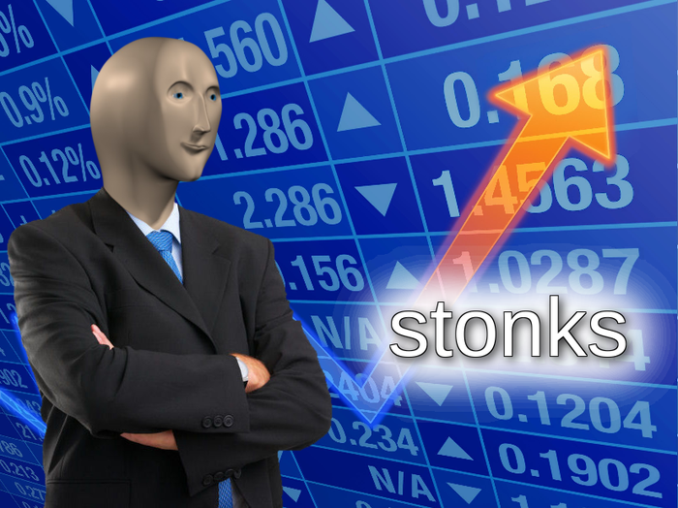
Is it the solution to all my problems?
Not quite right…

Slide 22
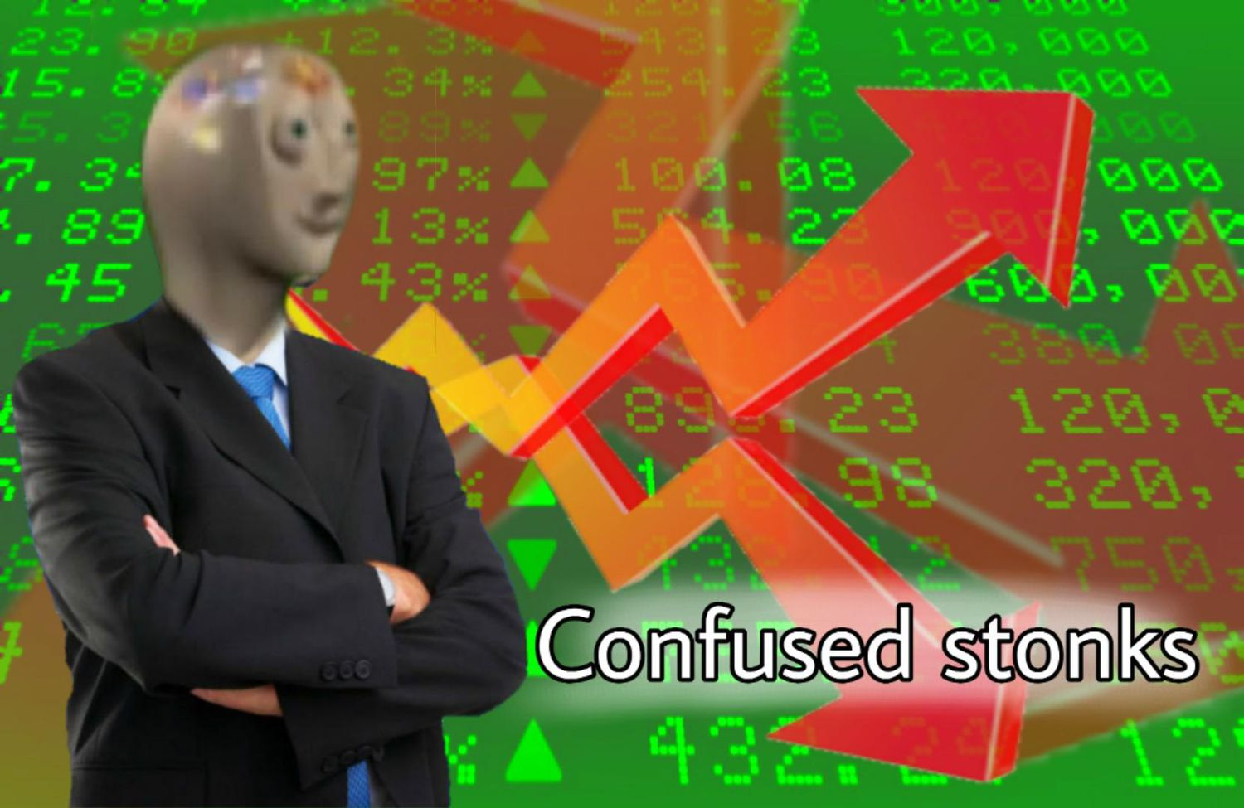
Nothing is perfect.
Not even your favorite programming language

Slide 23
“Don’t be a CV-driven-engineer”
- Some dude on the internet

Slide 24
Engineering is applying the correct solution to the right problem.

Slide 25

Thanks!
Contact us:
Twitter: @ramymawal
LinkedIn: /in/ramy-mawal
GitHub: RamyMawal
rmawal98@gmail.com

